Slide 1

Product Overview Search & Discovery

Slide 2
What is the Problem to be Solved?
How might we make it easier for veterans to find the information they need and the tasks they want to complete on VA.gov?

Slide 3
What does the data tell us?
On-Site Search
550,000
10%
#7
12%
Average number of searches conducted monthly
Daily site visitors use search
Among top site tasks
Month over month growth of on-site search since 1/20
30%
29%
Searches result
in a bounce
Searches result
in a refinement

Slide 4
What does the data tell us?
Off-Site Search
~95%
5%
32%
of referral traffic is driven by searches on Google and Bing
Average Google CTR
Bounce rate for site landing pages
87
22.8
Domain authority
Average Page Position on Google Search

Slide 5
What does the data tell us?
Search.gov – Keyword Analysis Insights
Top 10 Search Queries
loans
benefits
pension
burials
health
forms
jobs
dd214
ebenefits
direct deposit
Top Category of Searches*
Health (20%)
Education (14%)
Disability (13%)
Benefits (13%)
Records (11%)
Housing (8%)
Burials (6%)
Pension (4%)
Life Insurance (4%)
Careers (4%)
VA Employee (3%)
Top Forms Searched:
Form 21-4138 (32%)
Form 21-526ez (28%)
Form 21-0538 (8%)
Form 20-0995 (16%)
Form 21-686c (16%)
Notable Search Trend: Between May and November 2020: Search Query “Urgent Care” Jumped from #38 to #11 on top query list. Potentially highlighting pandemic and need for more medical care.
Make up 25% of all searches
*Add Loans, others?

Slide 6
What has been our initial focus?
Data Sourcing & Insights
Initial Bets & Tactics Q2-Q4/2020
Set-up Google & Bing Search Console
Audit Search.gov search terms data
Implement Search.gov click-tracking
Identify, answer and synthesize top questions
Create Domo dashboard for Search
Veteran User Research Plan
On-Site Search
Type Ahead POC
Click Tracking
Off-Site Search
Rich Results – FAQs
COVID-19 Test Sites for VAMCs
Local Listings Strategy

Slide 7
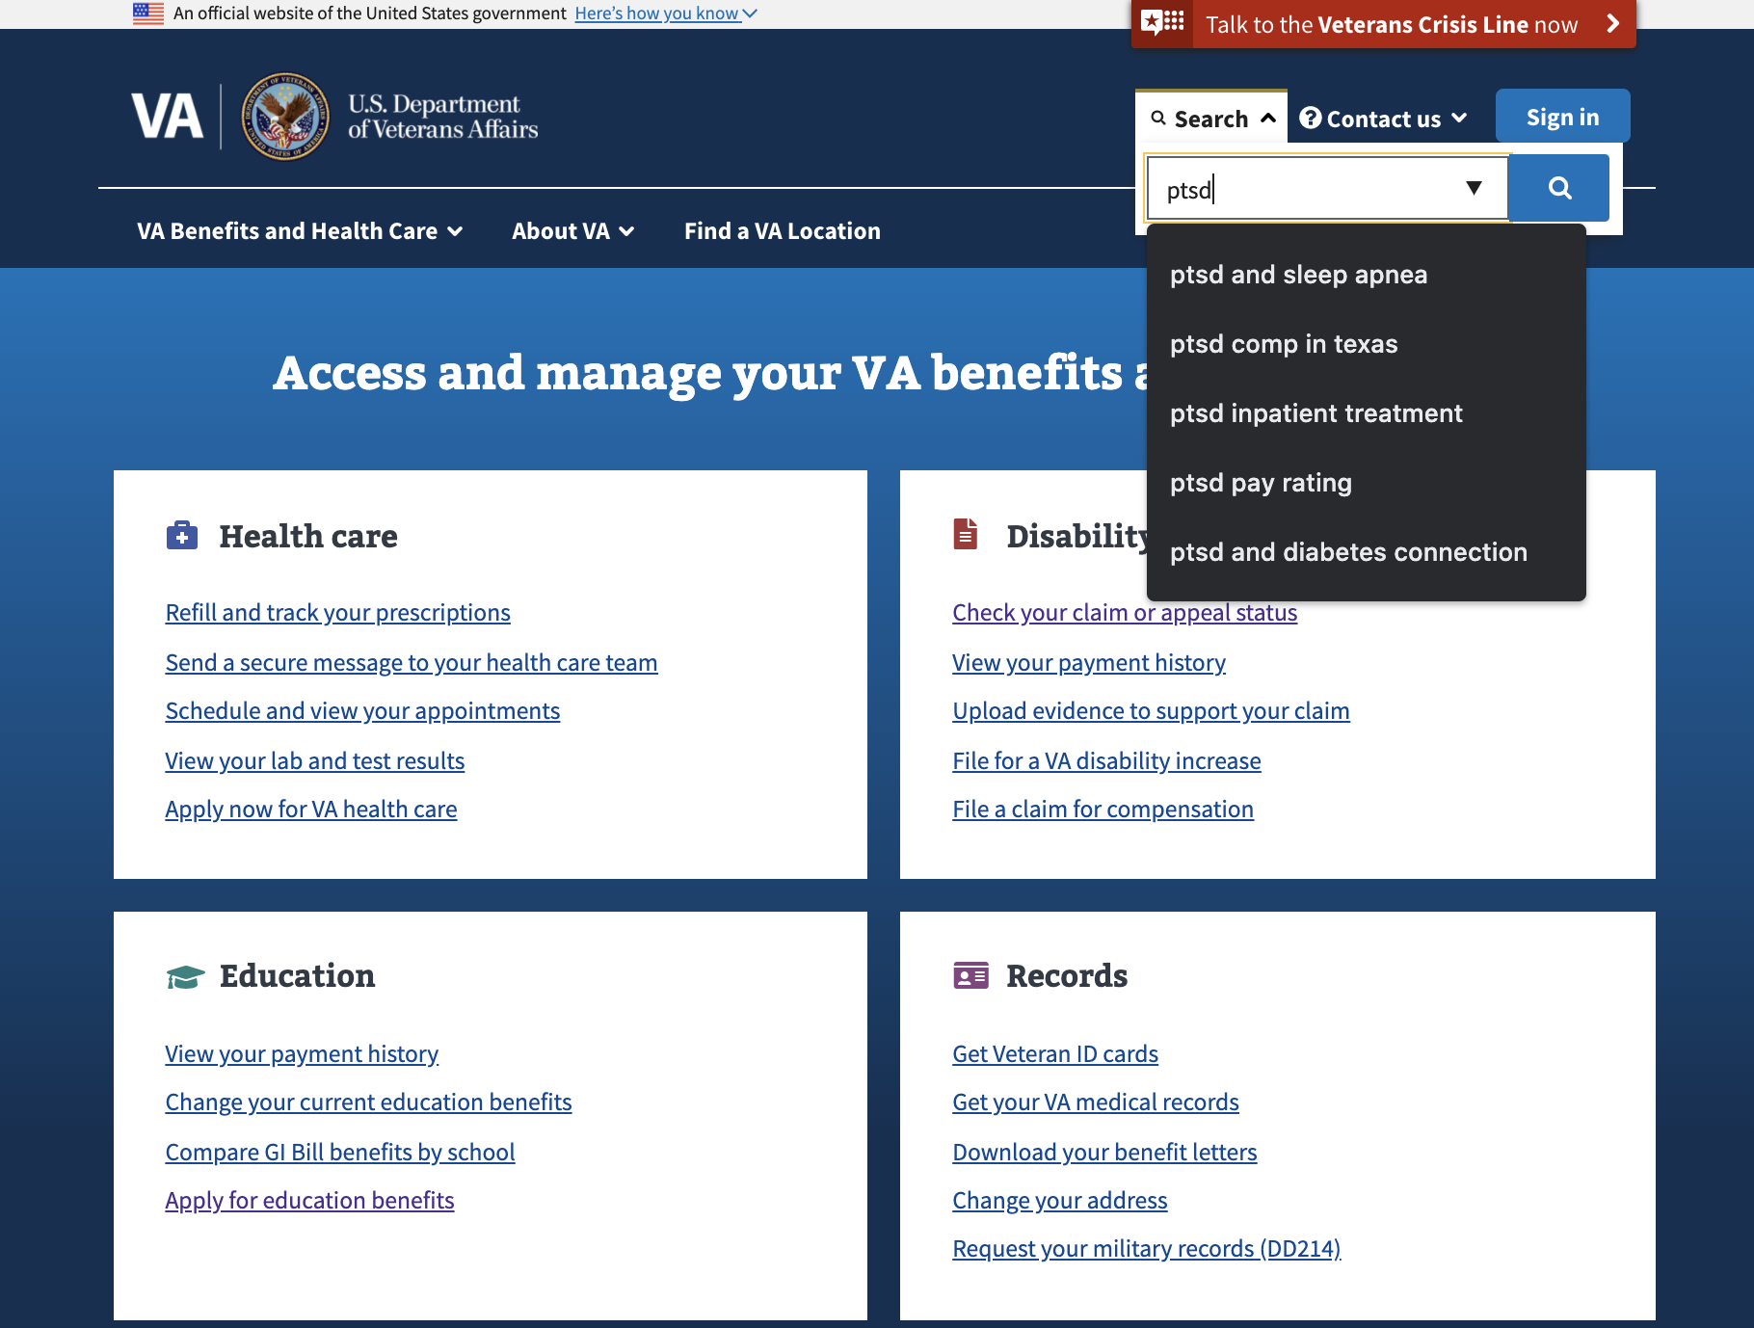
Initial Bets and Tactics
Type Ahead POC
User Story:
As a veteran, I need a faster, easier way to search for information on VA.gov so I can save time and avoid wading through lots of content.
Hypothesis:
If we leverage the type-ahead feature from Search.gov in on-site search then we can expect VA.gov site users to find what they need faster, saving time and reducing cognitive load.
Situation: Search.gov released Type-Ahead as an API enabled feature in late Q2 2020, but our audit revealed the suggestions are not as "relevant/valuable" as expected an issue which has been confirmed and is under investigation.
Strategy: Launch a four week Proof of Concept “as is” to ~5% of the VA.gov user base, capturing key data to measure impact to search effectivness.
POC Product Outline: https://github.com/department-of-veterans-affairs/va.gov-team/issues/8896
Analytics: https://github.com/department-of-veterans-affairs/va.gov-team/issues/13494

Slide 8
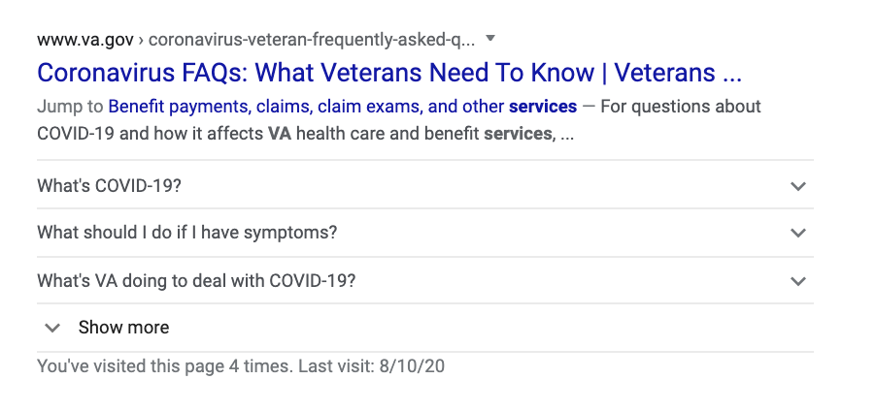
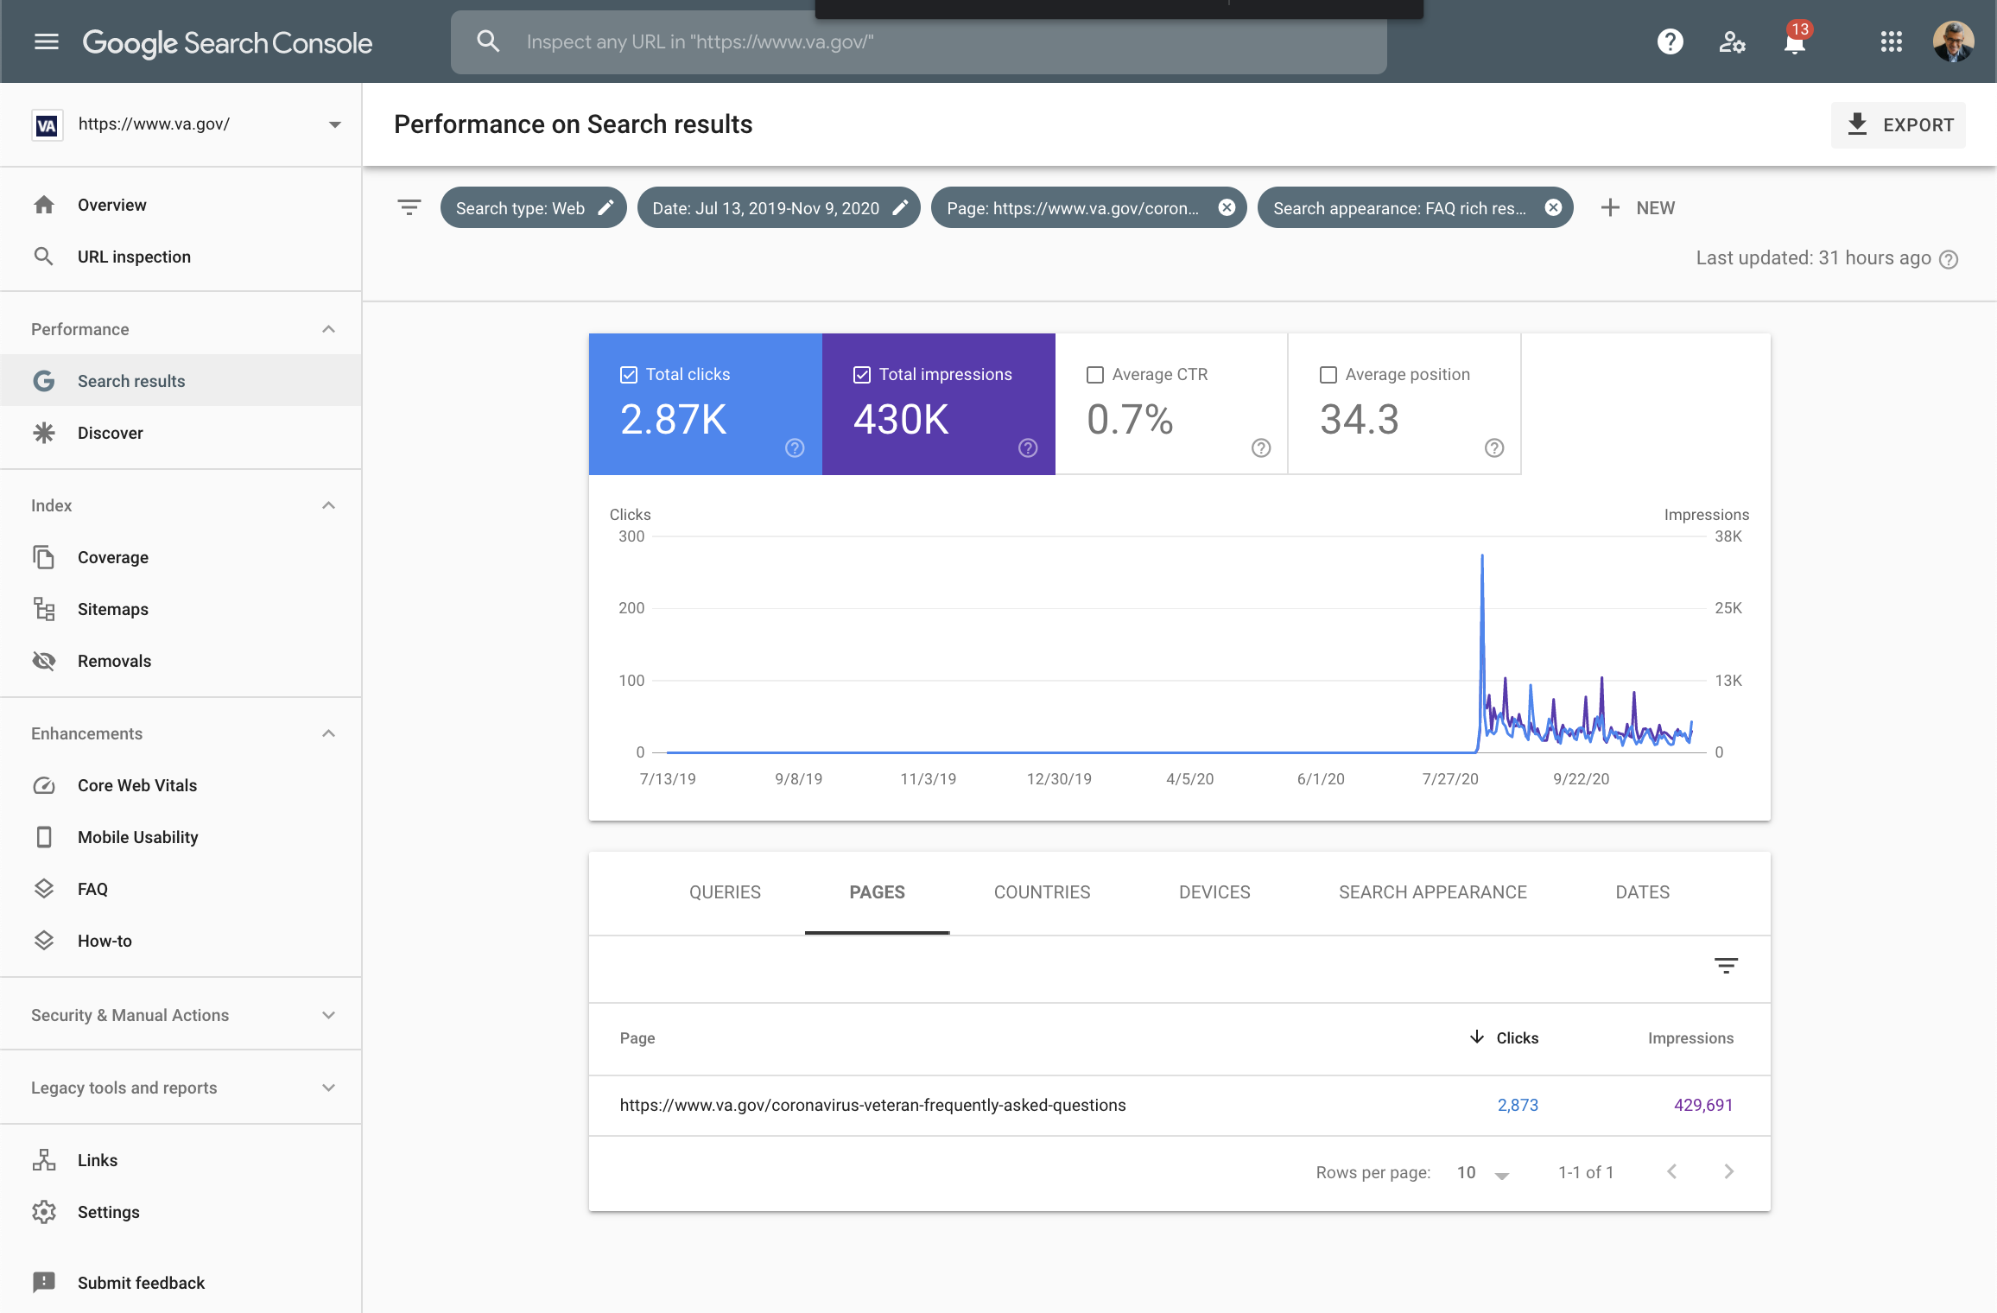
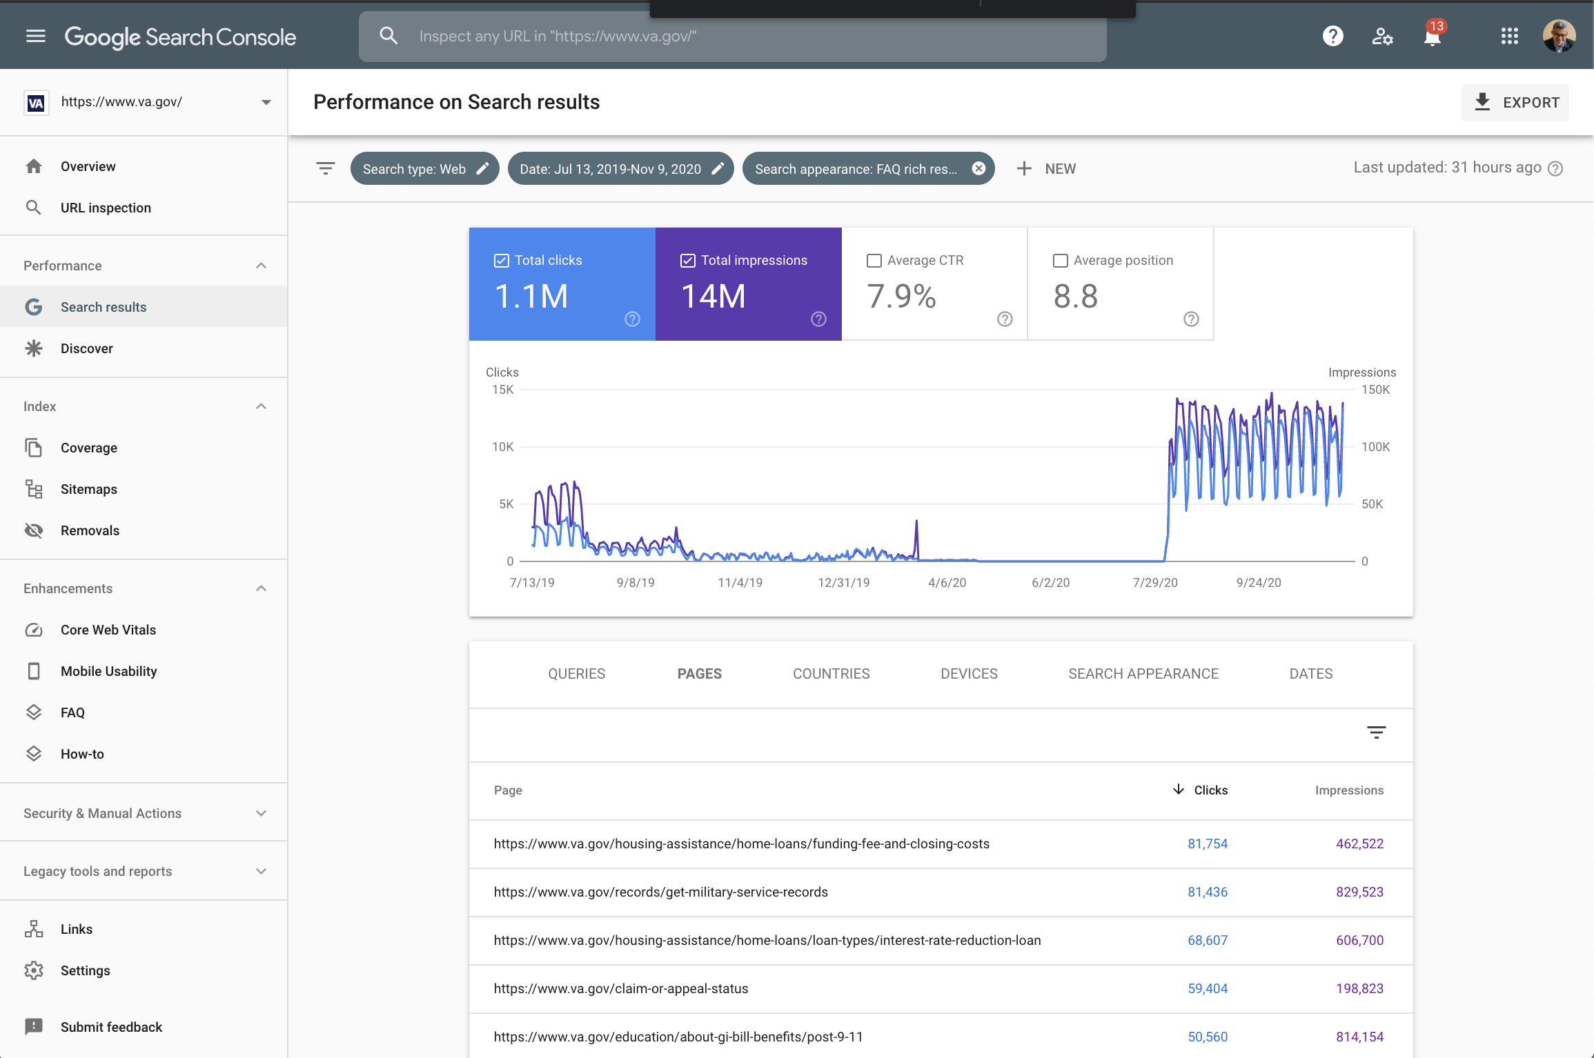
Initial Bets and Tactics
Rich Results (FAQs)
Hypothesis:
If we use structured metadata mark-up, we can create “rich results” Google/Search engine listings which will result in improved search rankings and click through rate.
Situation: Google has introduced an array of new tools (e.g. rich results testing tool, structured data gallery and the ability to track performance in search console), which VA.gov may be able to leverage to improve off-site search performance.
Strategy: Create a COVID-19 FAQ rich results markup to validate that the tools work and to determine if organic search performance (as measured by impressions and click through rate) is improved.
Finding: COVID-19 FAQ is not yet appearing for COVID/Coronavirus related queries, muting its performance CTR (0.7%). However, the overall performance for VA.gov FAQs is 7.9% compared to 5% for all terms.
Product Epic: https://github.com/department-of-veterans-affairs/va.gov-team/issues/10772

Slide 9
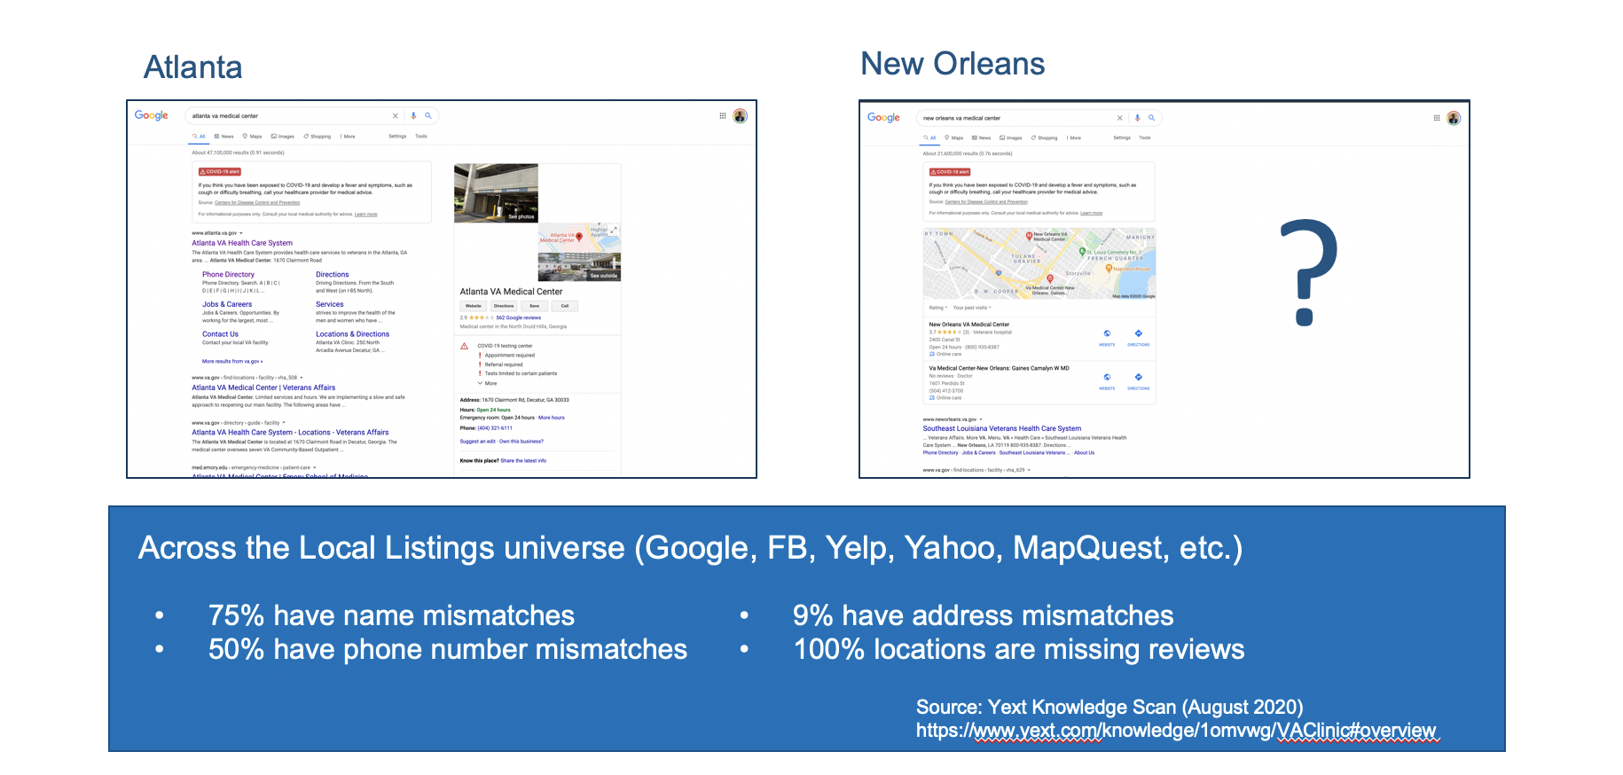
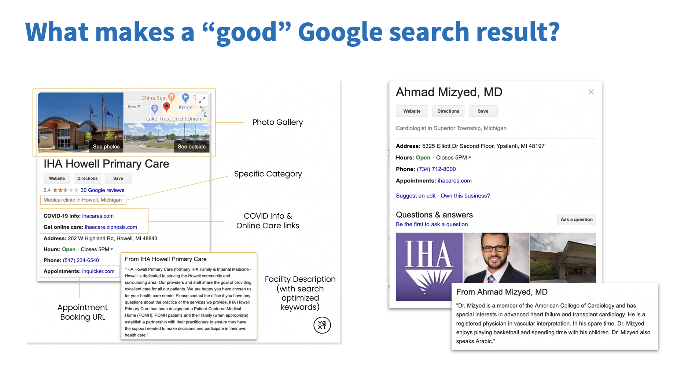
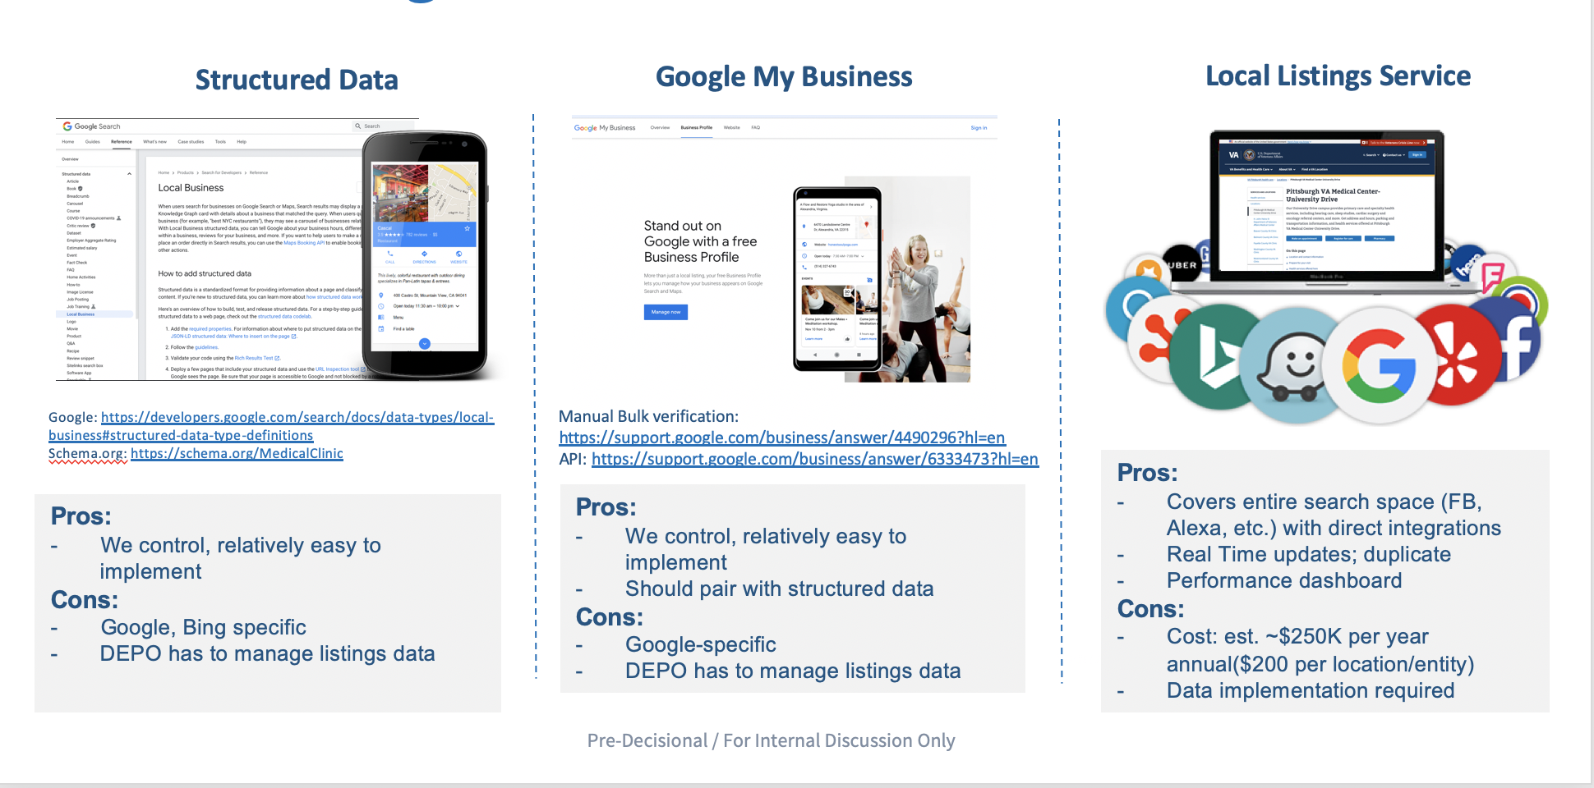
Initial Bets and Tactics
Local Listings Strategy
Situation: Google and Bing have evolved how they handle local listings (e.g. structured data, Google My Business). But the VA – which has the largest integrated health network in the nation with more than 1,200 local medical centers and clinics – does not have a modern, nor unified local listings strategy. The result: mis-matches in vital information, confusing facility names, lack of detail about services, etc.
Tactic: Conducted research and analysis to determine the state of VAMC local listings and outlined options for modernizing and unifying VA’s approach – e.g. structured data + Google My Listings vs. Local Listings Service.
Result: Shared findings with VACM Product Owner Dave Conlon and DEPO product leadership leading to decision: Local Facilities/VAMC product team will take on this initiative in 2021 as part of their wide rollout of new VAMC sites. (Note: Our team may serve an advisory role.)
Strategy Deck: https://github.com/department-of-veterans-affairs/va.gov-team/blob/master/products/public-websites/offsite-search/VA.gov_Search_Local_Listings_Options%202.pdf

Slide 10
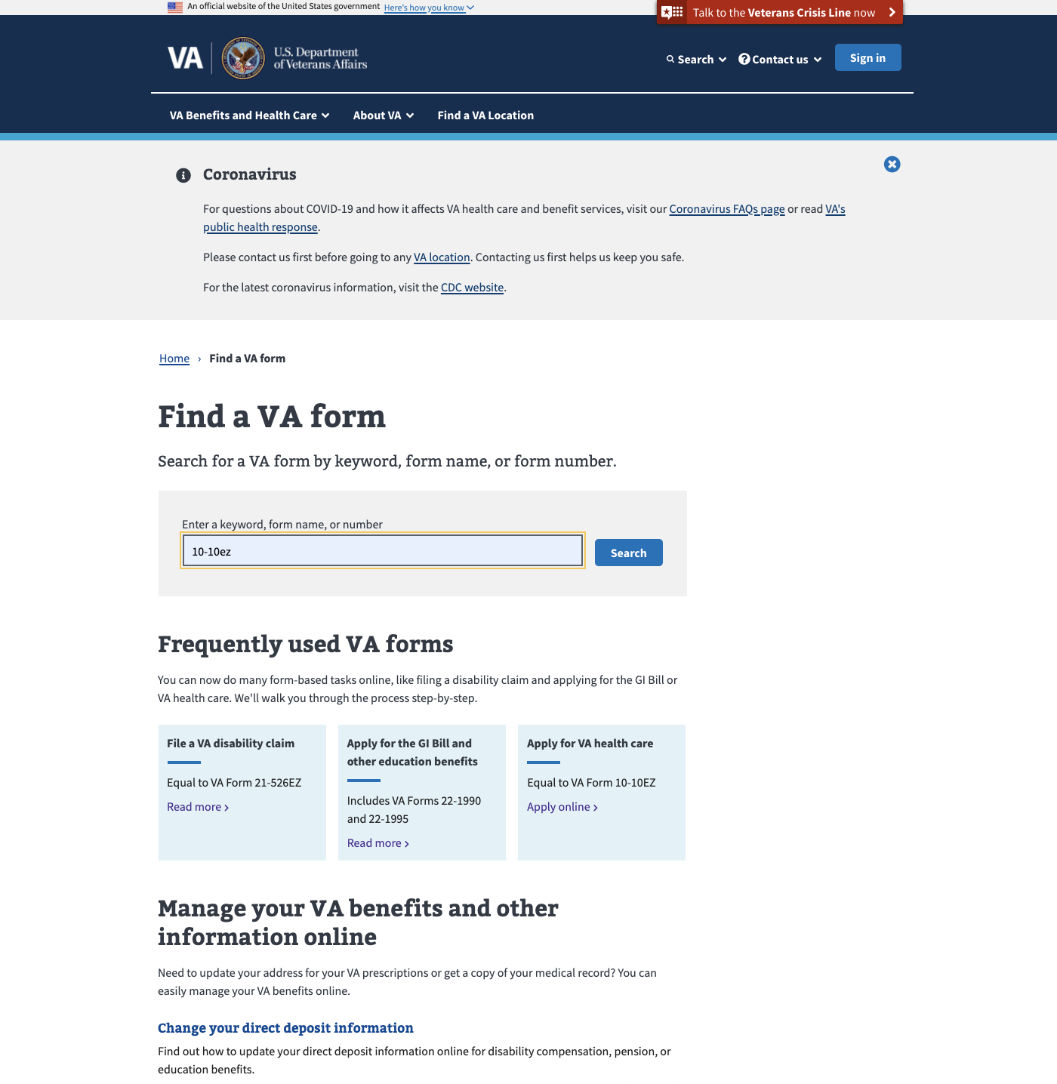
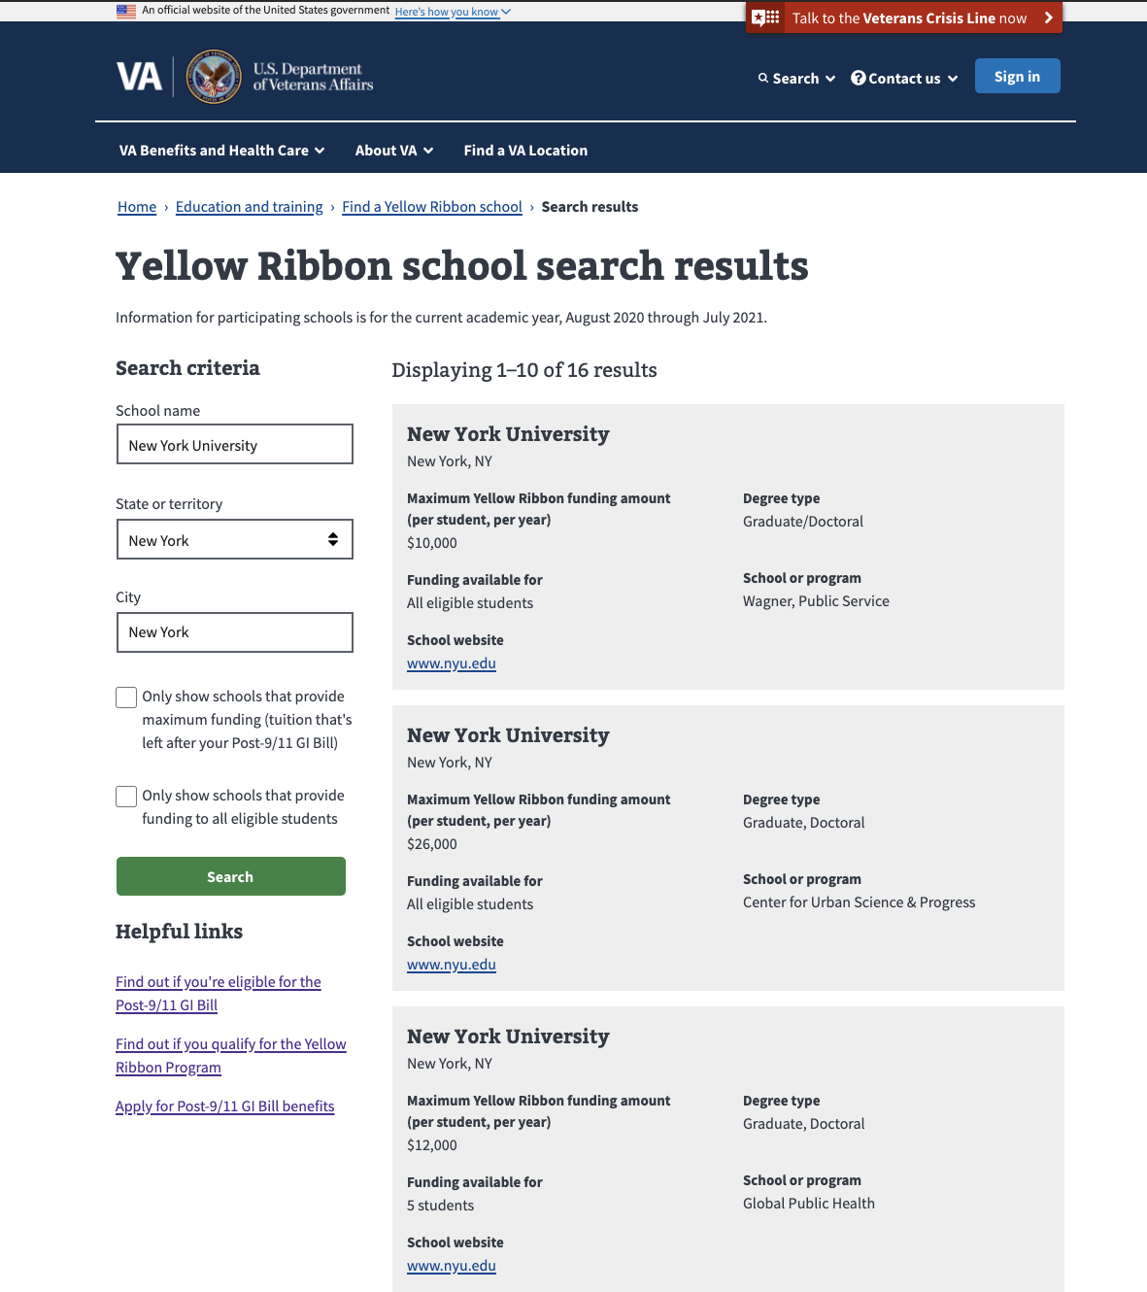
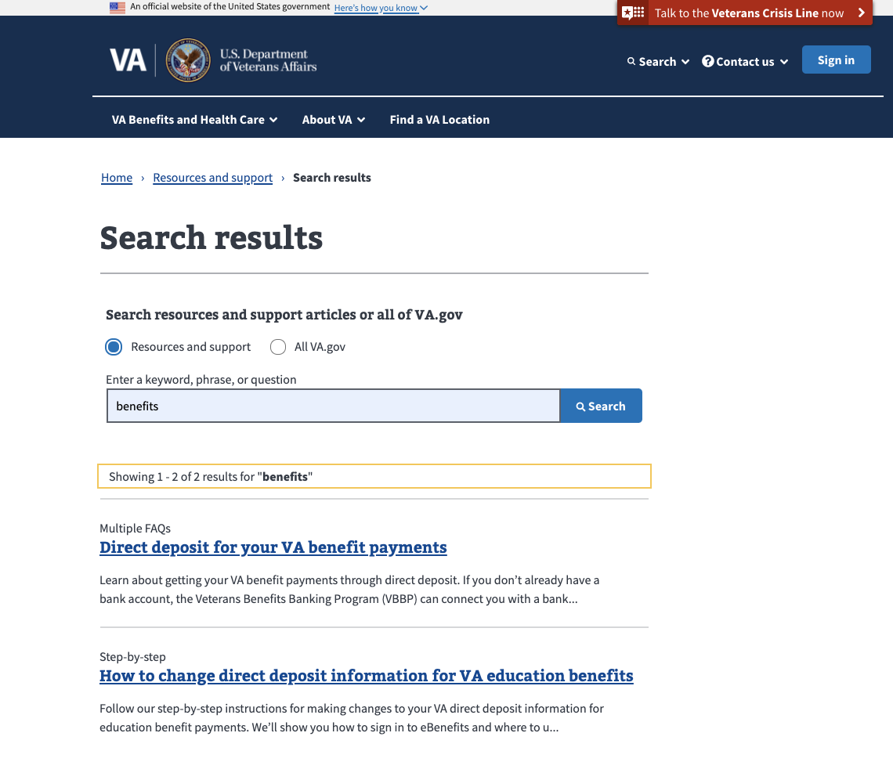
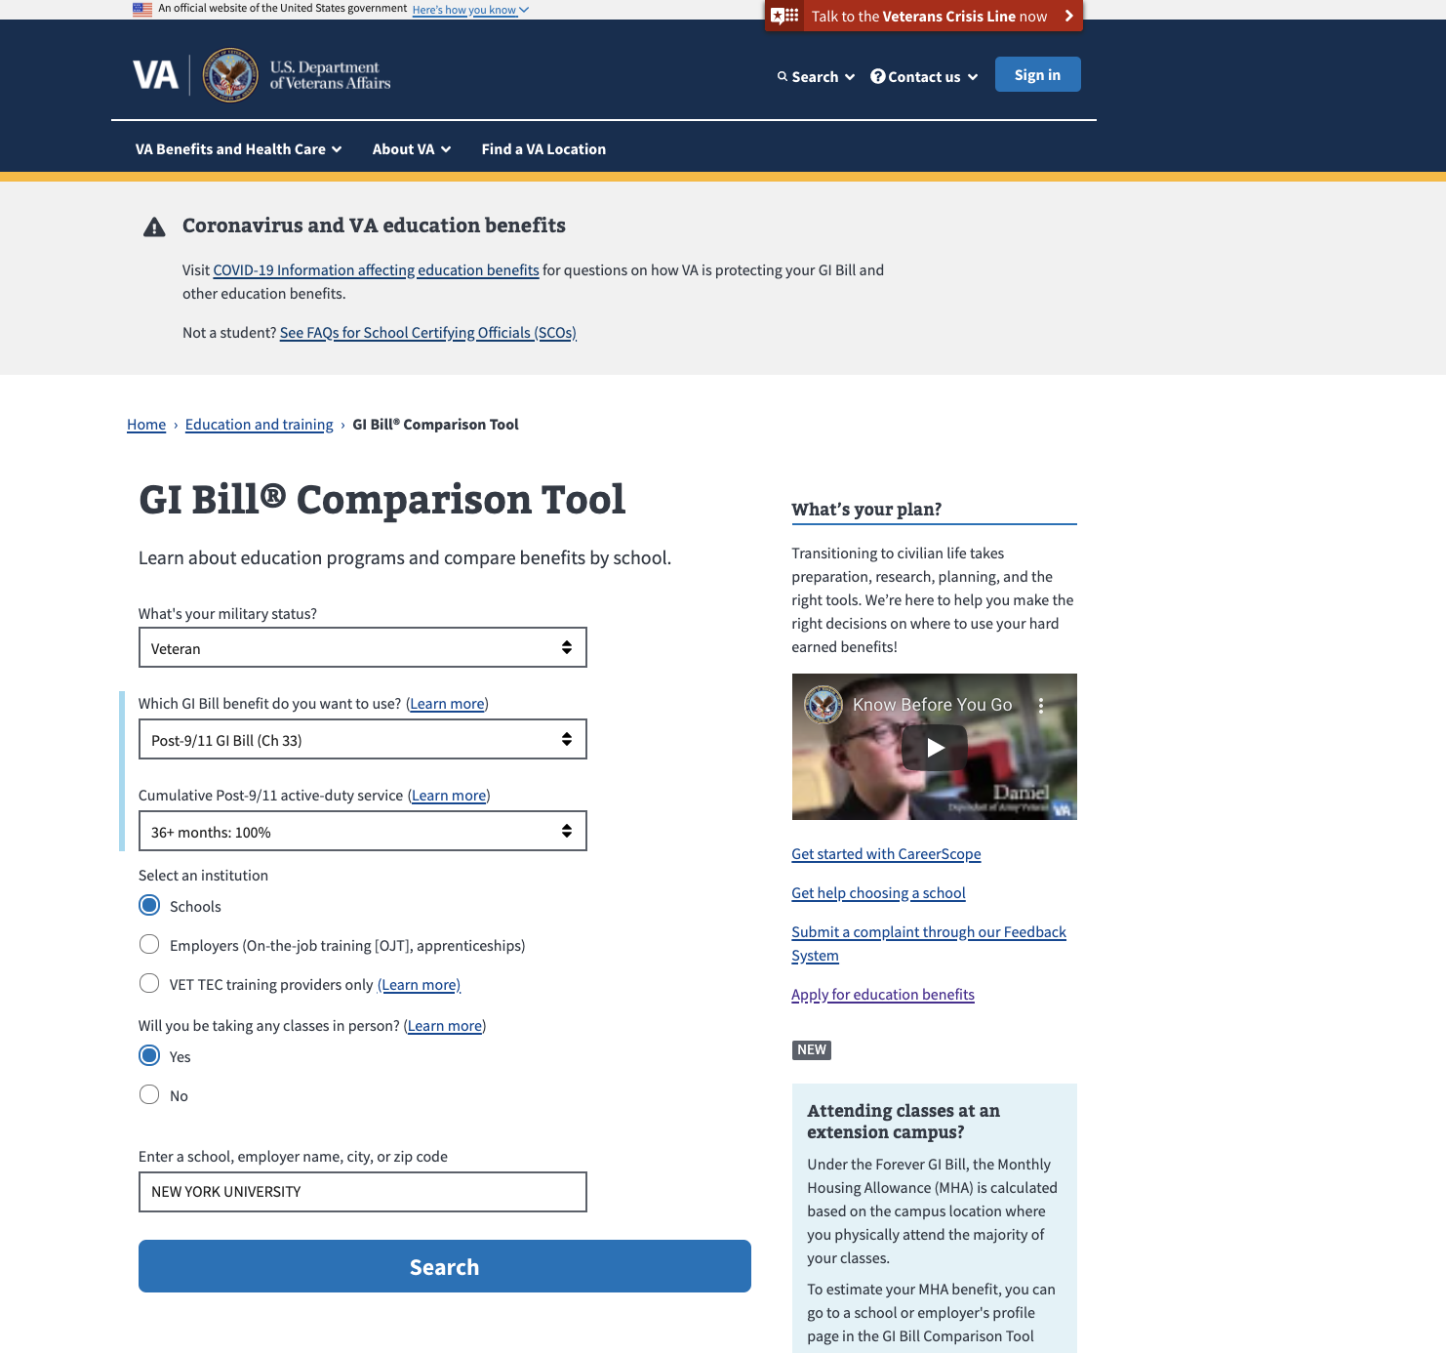
Custom Search and “Look Up” Utilities
The VA.gov site features custom search and “look up” tools and experiences which are not powered by Search.gov. These include:
Resources & Support (Public Websites)
Find a Form (Decision Tools)
Yellow Ribbon Program Schools (Decision Tools)
GI Bill Comparison Tool (BAH)
More details about how these search utilities work (database, Drupal, etc.) will be provided by Nick Sullivan on Wednesday.

Slide 11
The Road Ahead at a Glance
 | Q4 2020 | Q1 | Q2 | Q3 | Q4
Themes | Problem Framing | User Research | Features
On-Site | Implement Click-through Analytics Launch Type Ahead POC Finalize User Research Plan | Complete User Research Plan Set Up Domo Dashboard Update Best Bets Launch Type-Ahead 1.0 (with Whitelist?) | TBD | TBD | TBD
Off-Site | Complete workflow for Castlight/Google COVID-19 test site updates and hand-over to VHA DigCom. | Set Up Domo Dashboard Evolve Site Map XML Evaluate Site SEO Optimization

